Slide 1
Does it Apply to the US Economy?
The Phillip’s Curve and the Relationship between Unemployment and Inflation
Christian Conroy

Slide 2




Agenda
Does the Phillip’s Curve Hold for the United States?
What is the Phillip’s Curve?
Does the Phillip’s Curve Apply to the United States?
Doe the relationship between unemployment and inflation change over time?
What correlations between unemployment and inflation exist?

Slide 3





Wages
Natural Rate of Unemployment
Inflation Targeting
Productivity Growth
Global Factors

Slide 4
Does the Phillip’s Curve Hold for the United States?

Slide 5
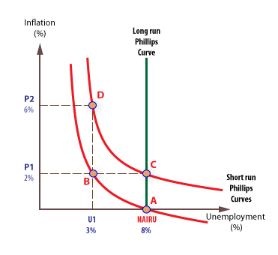
What is the Phillip’s Curve
Suggests that a higher inflation rate will come with lower unemployment
As employers run out of potential workers who do not already have a job, they’ll have to outbid other firms
The idea is that employers finding it harder to fill jobs will pay higher wages and thereby spur inflation

Slide 6
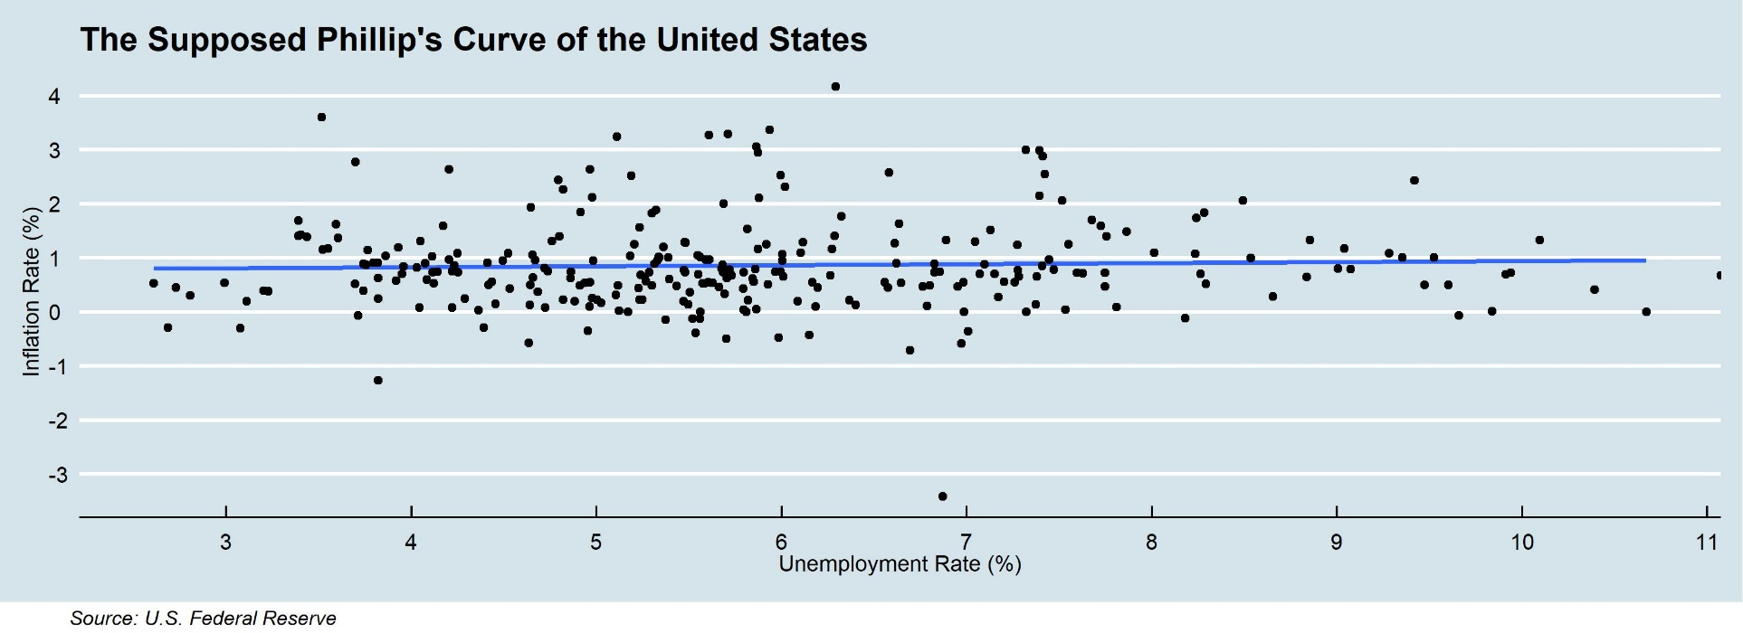
Does the Phillip’s Curve Hold in the United States?

Slide 7
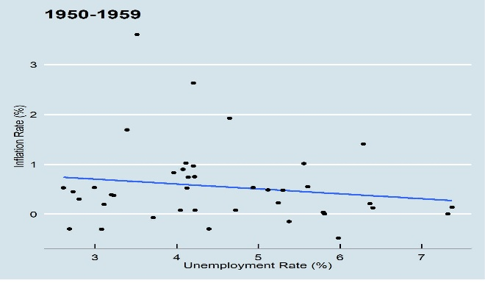
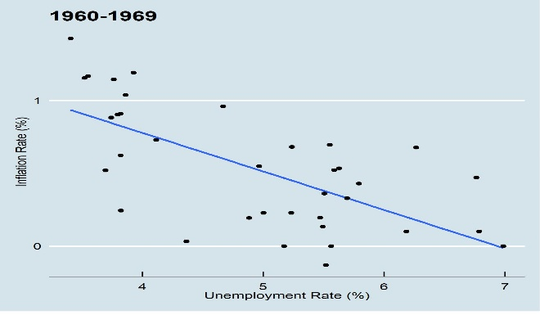
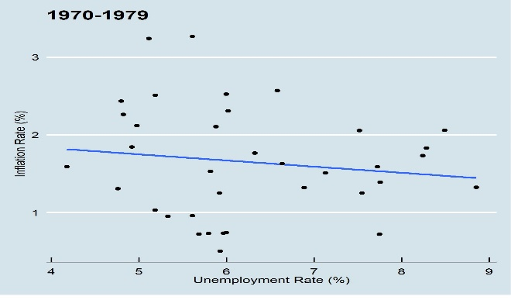
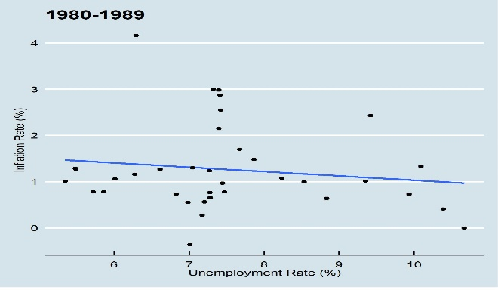
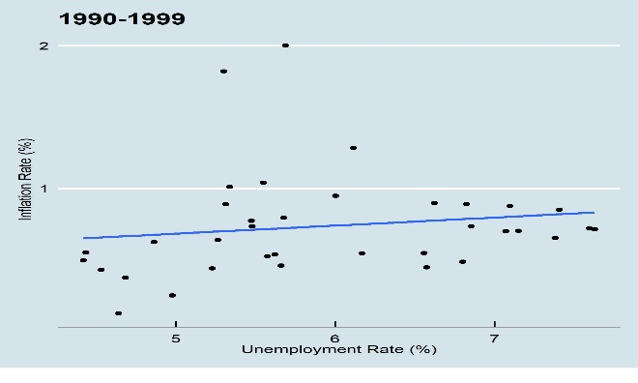
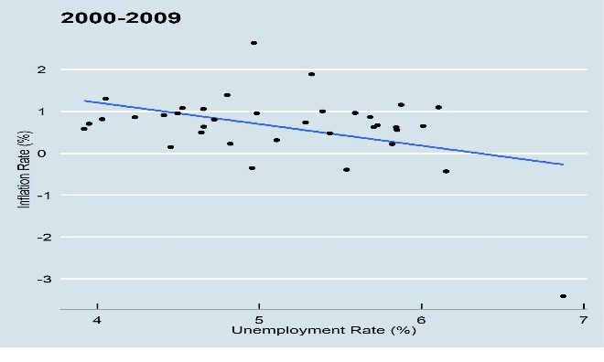
Did the Phillip’s Curve Ever Hold in the US?
Decade of Prosperity
Wartime Inflation
Stagflation and FRA
Recession and IR Increase
Savings and Loan Crisis
Dot-com and GFC

Slide 8
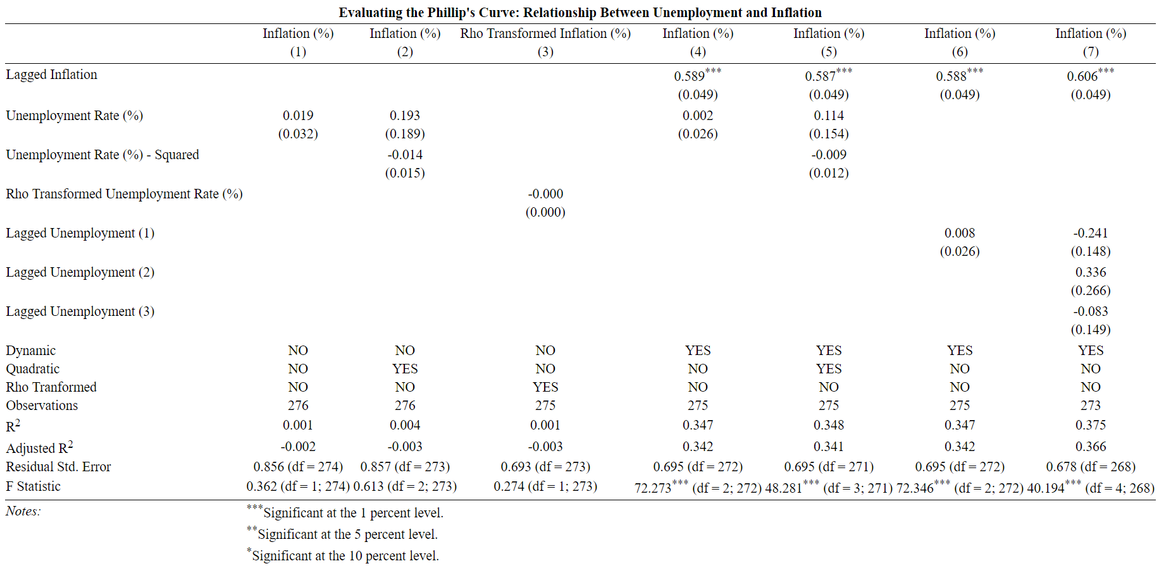
Does the Phillip’s Curve Hold in the United States?

Slide 9
Other Factors Influencing the Relationship Between Inflation and Unemployment in the United States

Slide 10



It’s Not Just About the Direct Relationship
Other Factors Can Have Large Impact on the Relationship Between Unemployment and Inflation
Wages
More Flattening
Lower Rates of Unemployment Not Leading to Higher Wages
Natural Rate of Unemployment
The slack between the unemployment rate and the natural rate of unemployment matters far more
Inflation Rate Targeting
Changing what constitutes expected inflation may have flattened the curve
Productivity
Higher Wages do not always follow productivity gains
Global Factors
Factors like rising oil prices and global economic slack exert pressures on US inflation
Notes:
Sit here more

Slide 11
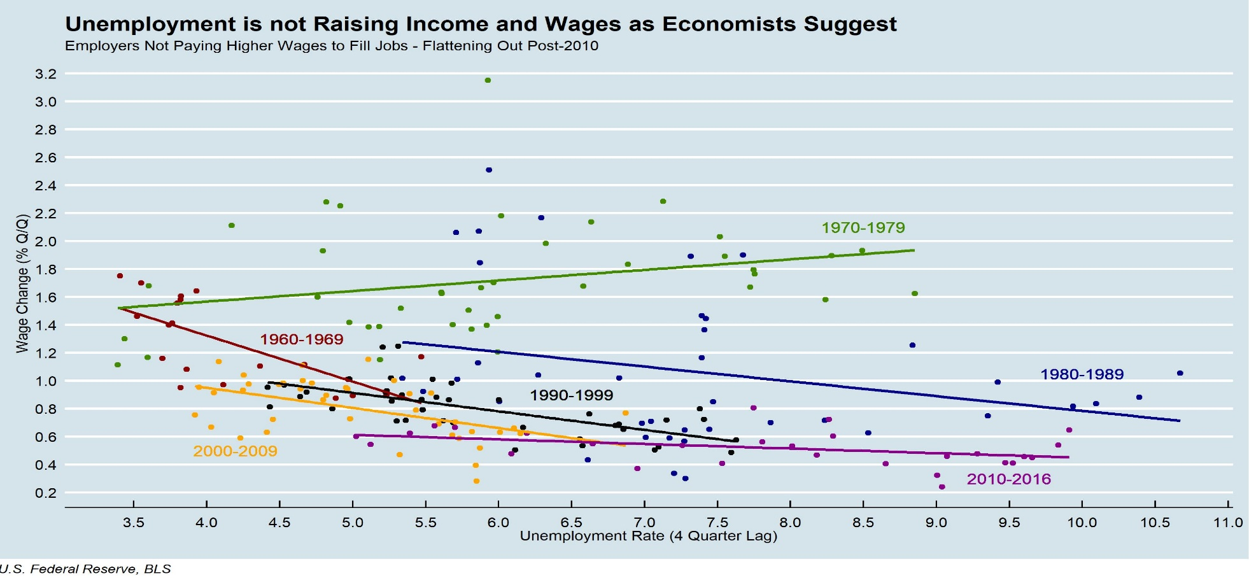
The Broken Chain Between Unemployment and Wage Increases

Slide 12
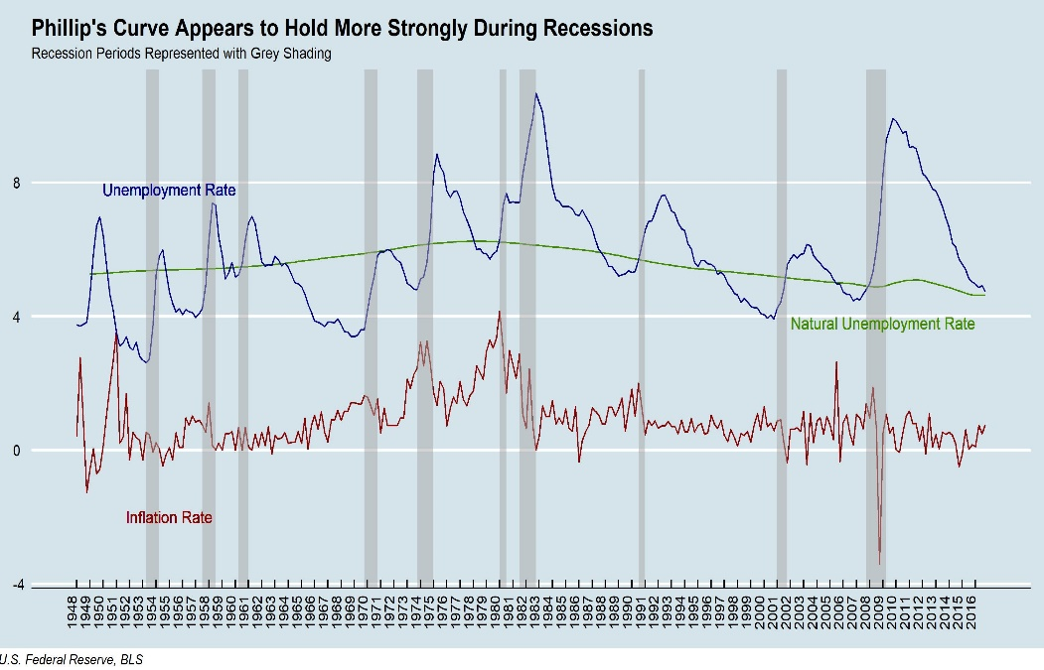
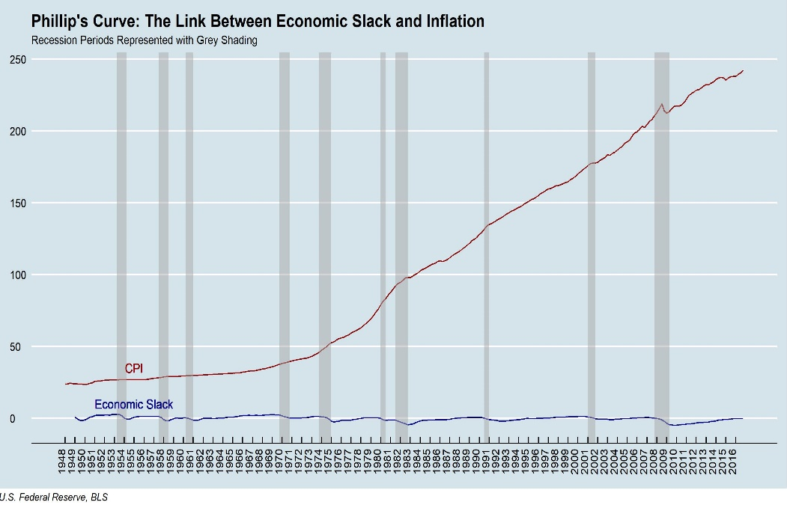
Economic Slack is More Important than the Unemployment Rate

Slide 13
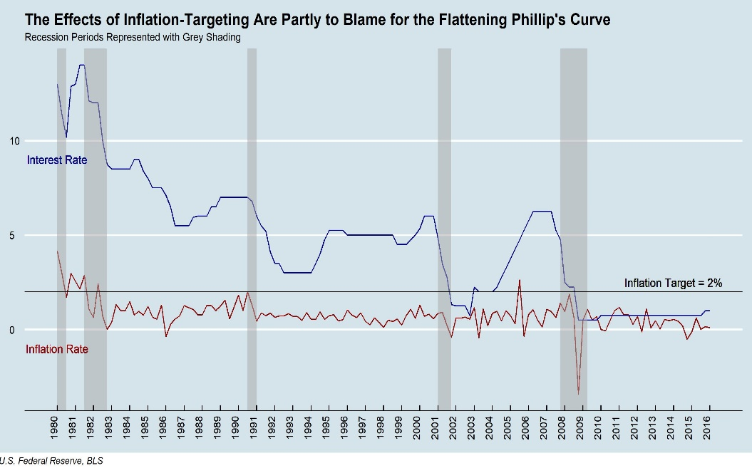
Did the Adoption of Inflation Targeting Flatten the Curve?
Inflation targeting may have flattened the Phillip’s curve
In 2012, US Federal Reserve Chairman Ben Bernanke set a 2% target inflation rate
People are expecting the target rate of inflation and ignoring what they see as temporary inflation fluctuations
What matters then is unexpected inflation
The FOMC cannot effectively use interest rate adjustments under an inflation targeting policy

Slide 14
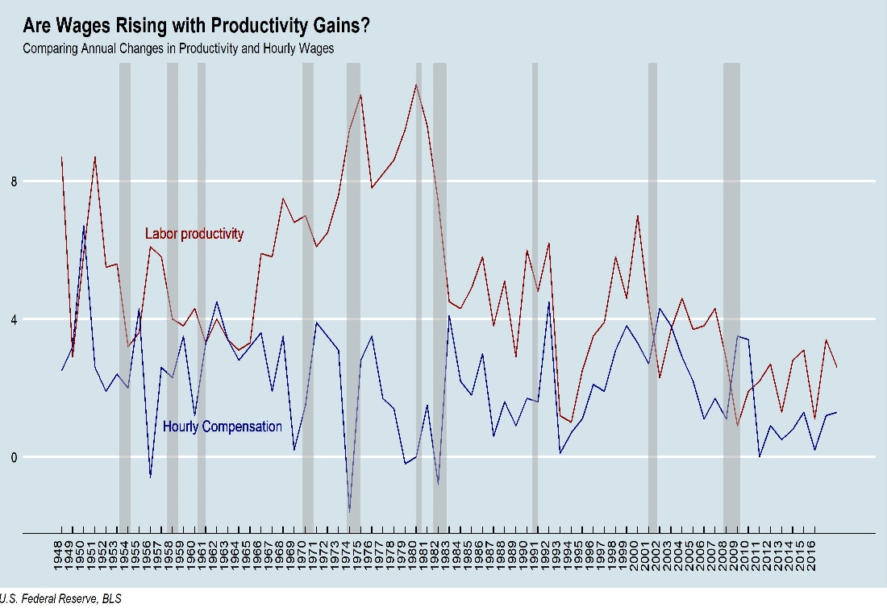
Are Wages Keeping Up with Productivity Gains?
As productivity increases, new workers are entering the market that do not necessarily have high wages
Productivity increases often come without the need for higher wages due to technological advancement and automation
Higher productivity may also lead to higher working pay that does not translate into higher prices via inflation

Slide 15
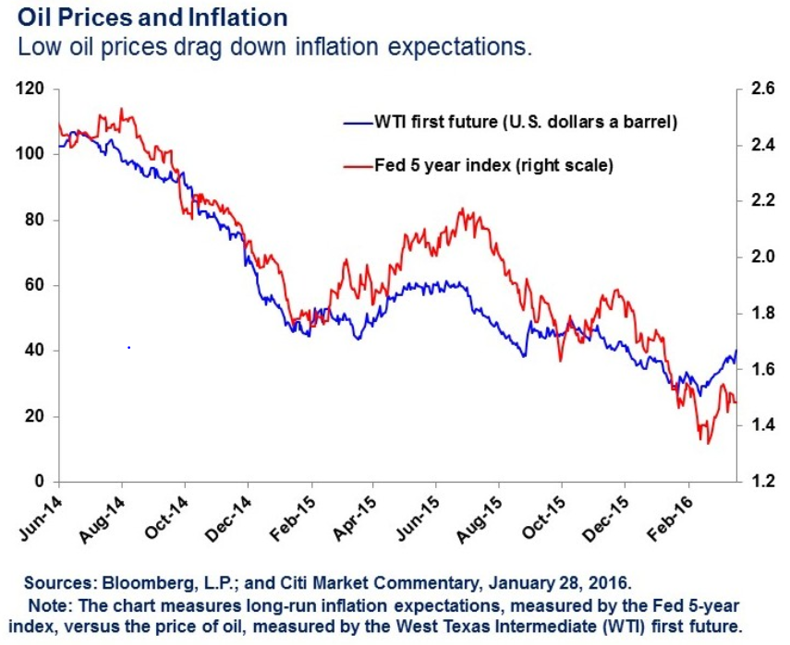
There is no way to Geographically Contain the Relationship
Global economic forces
Global economic slack may exert downward pressure on US inflation
Higher import prices with lower energy prices and higher dollar can produce disinflation
Higher oil prices may be keeping inflation above 2% target rate
Methodology Issues
The official unemployment rate may not actually capture the number of potential workers

Slide 16
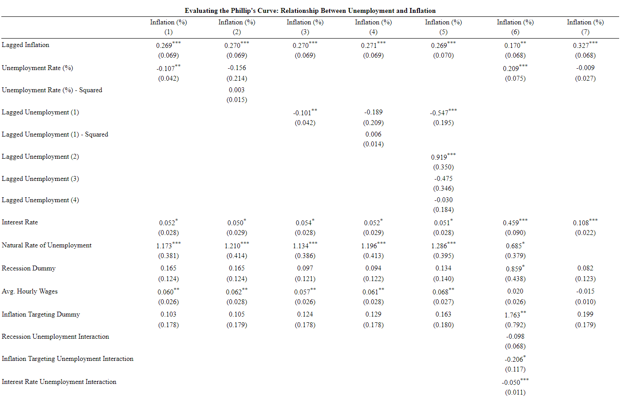
Does the Phillip’s Curve Hold in the United States?

Slide 17
Implications of the Breakdown of the Phillip’s Curve

Slide 18

Policy Implications
Under inflation targeting, stronger bank capital buffers may be more effective than interest rate management
Letting prices rise or fall based on economic slack rather than the Phillip’s Curve more effective

Slide 19
Thank you
Christian Conroy

